Slide 1
Dental Clinic Problem
Samiha Masrura
2020-1-60-066
Farhan Tanvir
2020-1-60-132
Md.Safayet Islam
2020-1-60-131
Md. Shah Nawaj
2020-1-60-213

Slide 2
Project Description
The question states that this dental clinic has one dentist with one dental chair and n chairs for waiting. When there is no patients , the dentist sleeps in his chair. When a patient arrives he has to wake up the dentist. Only one patient can attend the dentist at a time. Other patients will wait if there is empty chairs otherwise they will leave.

Slide 3
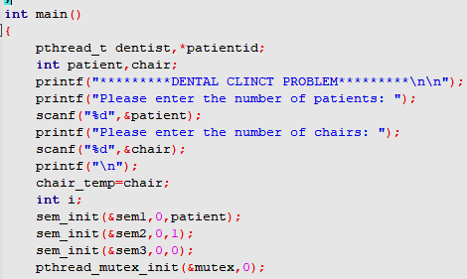


Topic Discussion
We used
Thread
Semaphore
Mutex lock.

Slide 4
Start
Project’s Flowchart
Input
No
Doctor Available?
Yes
No
Yes
Empty Chair?
Leave
Wait for Dentist
Take Treatment
End

Slide 5
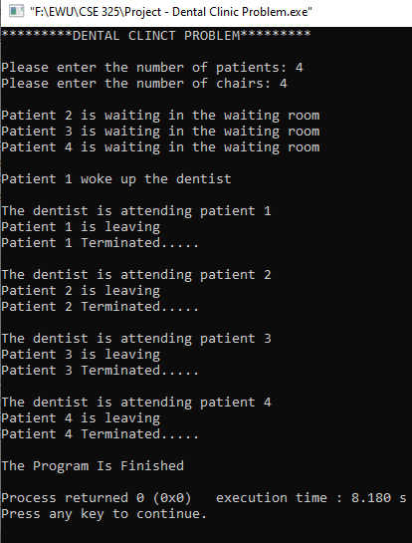
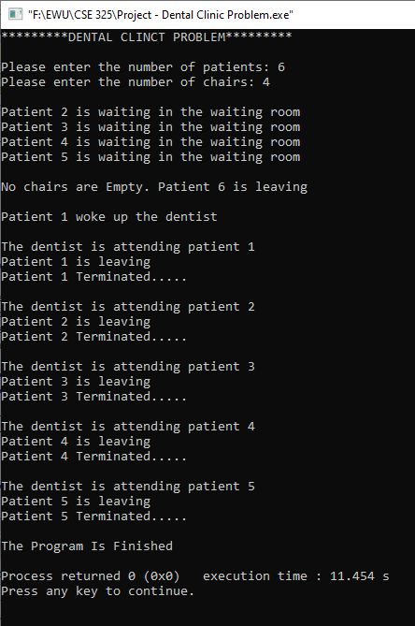
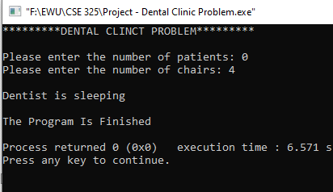
Output :

Slide 6
Thank You

